Slide 1
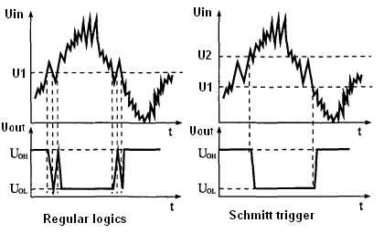

Slide 2
J2
If V_{in} is 1 V what is V_{out}?
0V
1 V
-1 V
15 V
-15 V
+15 V
V_{in}
V_{out}
-15 V

Slide 3
J3
If V_{in} is 1 V what is V_{out}?
0V
1 V
-1 V
15 V
-15 V
+15 V
V_{in}
V_{out}
5V
-15 V

Slide 4
J4
If V_{in} is 8 V what is V_{out}?
0V
1 V
-1 V
15 V
-15 V
+15 V
V_{in}
V_{out}
5V
-15 V

